Slide 1
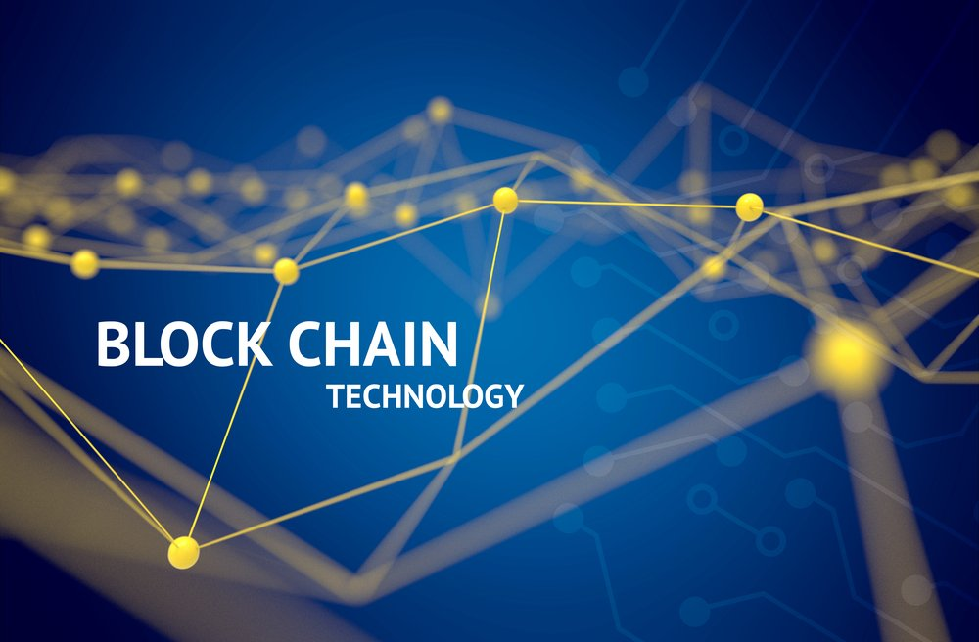
Blockchain

Slide 2
Before we talk about it, it's important to understand , why we need blockchain? . Imagine someone named Ibrahim living in Riyadh, for example, who wants to transfer 50 dollars to Ahmed, who lives in Cairo. The traditional way to do this is for Ibrahim to head to a bank in Saudi Arabia and transfer the money to Ahmed's account. He can also transfer money through another financial intermediary, or one of the money transfer agencies, like Western Union. The problem with this method is that if Ibrahim wants to transfer 50 dollars, he will have to pay in the course of the transaction. The same may happen to Ahmed, he may have to pay a fee to withdraw his money. In addition, there was a problem of privacy, since the third party that mediated between Ibrahim and Ahmed would know a lot of personal information about them, which had nothing to do with the transfer. . What if there is a way to transfer money from one person (or company) to another without any mediation or interference from a third party, without any additional fees, and it happens instantly, and above all, the transaction is protected, and the parties to the process need not reveal any personal information about them.

Slide 3
The main problem that blockchain technology has solved: . is the problem of trust, in the digital world that we live in today, people are selling and buying remotely, money is needed, whether for digital trade or direct transactions, and many governments and departments have been serving citizens over the Internet. In the past days, people have been building trust in each other through direct transactions. Today, confidence in the digital world is risky. Because you don't see who you're dealing with, so there's a mechanism to prove identity. It has become possible to meet these demands, and users will share only the amount of personal information necessary to conduct the transaction.

Slide 4
The blockchain technology was first introduced in 1991 by Stuart Haber and Scott Stornetta, researchers who wanted to introduce an impenetrable system. After this introduction, we will go into the definition of blockchain and how it works and uses it. What's a Blockchain ? . Technology that allows a person or company to transmit value assets to another person safely and without the interference of another party, . A series of records or fixed blocks of data is managed by a set of computers not owned by any one entity. Data blocks are secured and linked using encryption principles Data Storage . The normal method of storing information differs from that of storing on blockchain ,Where general data is stored in tables (Excel sheets, Data Base, or server) but , Storage blockchain is encrypted and placed in blocks in tables, and these blocks are linked sequentially to each other.

Slide 5
First Decentralized Application of Blockchain Technology: Bitcoin ₿ . The most important blockchain application of all is bitcoin, which has occupied the world in the last few years. . Bitcoin app was created at the end of 2008, an unknown person (or several people) called Satoshi Nakamoto reached the bitcoin protocol. Thus, a new financial and technical revolution began, leading to the global economic system. This Protocol has made it possible to dispense with intermediaries and third parties and has provided a secure regime. . Bitcoin as its owners know it is an innovative payment network and a new form of money. It is a cryptocurrency, a form of digital cash. It is a decentralized digital currency that is not controlled by any authority or central bank, and can be sent from one user to another without the need for intermediaries. Blockchain technology is used. . Bitcoin is open source, no one owns or runs a bitcoin network and anyone can participate in it. There are now over 16 thousand digital coins on the blockchain network Bitcoin Details Current Market Cap More than 875 billion Price Bitcoin ₿ : 46,300$ [ Today 4/1/2022 ]

Slide 6
Smart Contracts . Smart contract is a computer code that can be included in a blockchain to write, verify and negotiate a contract. Smart contracts operate under a range of user-approved terms. When those conditions are met, the Convention is automatically implemented. Let's say, for example, you want to rent me an apartment using a smart contract. The deal is I'll give you the access code once you pay me a month. We'll write the deal into a smart contract, which will automatically exchange the apartment's access code for rent when it's time to pay. Of course, smart contracts are still in their infancy, right now, smart contracts can only be programmed to perform simple functions. . Ethereum is one of the most popular platforms for smart contracts, an open-source project using blockchain technology.

Slide 7
The Strongest Networks on The Blockchain . Bitcoin Network , Ethereum Network , Solana Network Inter-network competition takes place in terms of reducing the cost of Gas Fees and the speed of the transaction per second. . The most common fields of blockchain technology Non-fungible token (NFT) Metaverse . There are more than 3,858 decentralized applications on the . blockchain network , and one of the most popular applications is used. Brave [ Browser ] IPFS [ Storge ] Steemit [Social Network ]

Slide 8
الأسماء: 1- روضة عبدالراضي محمد صياح / عــام / مجموعة (1) 2- سلمي أبو بكر محمود عمر / عــام / مجموعة (1) 3- زياد محمد هاشم خفاجي / عــام / مجموعة (1) 4- عبدالرحمن عمر فاروق محمد / عــام / مجموعة (1) 5- سرابامون برسوم بخيت حبيب / عــام / مجموعة (1) 6- عبدالعزيزعبدالرحمن عبدالعزيز عبدالرحمن / عــام / مجموعة (1) المصادر: State OF the Dapps Coin Market Cap Wikipedia mostaql

